Slide 1

Final Project at Wild Code School
Research, meet Industry

Slide 2
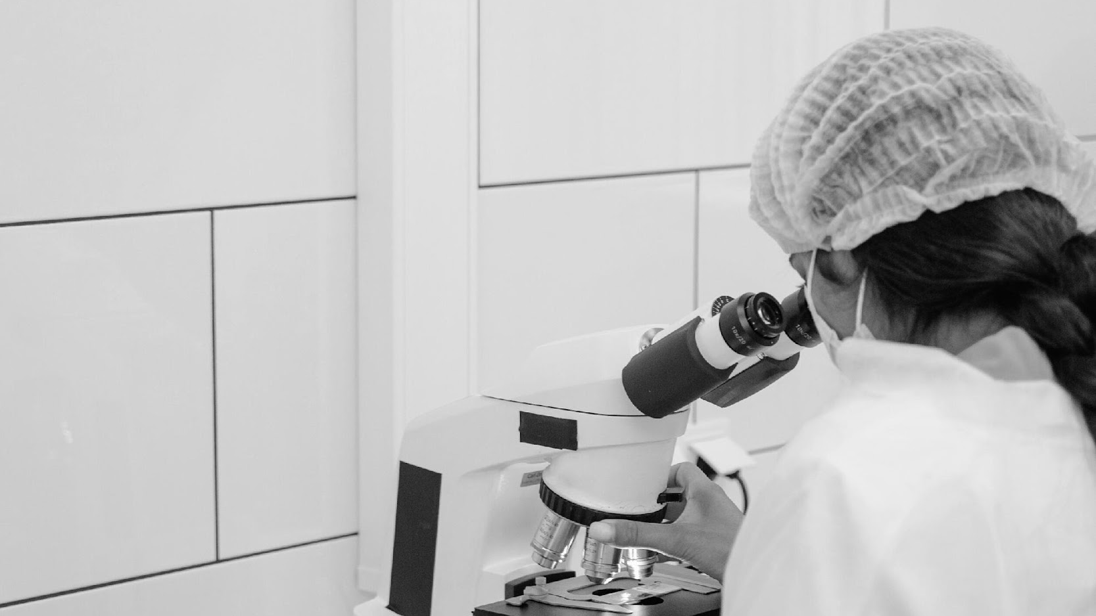
Hi!
I’m Marta, and I'll be sharing my final project with you.
Follow me at @martalbarbosa
to learn more.
01

Slide 3
Agenda
01
02
03
Context
Technology
Dashboard
Contextualize with the datasets used
Present you the technology used
Show you the results in the form of a dashboard

Slide 4
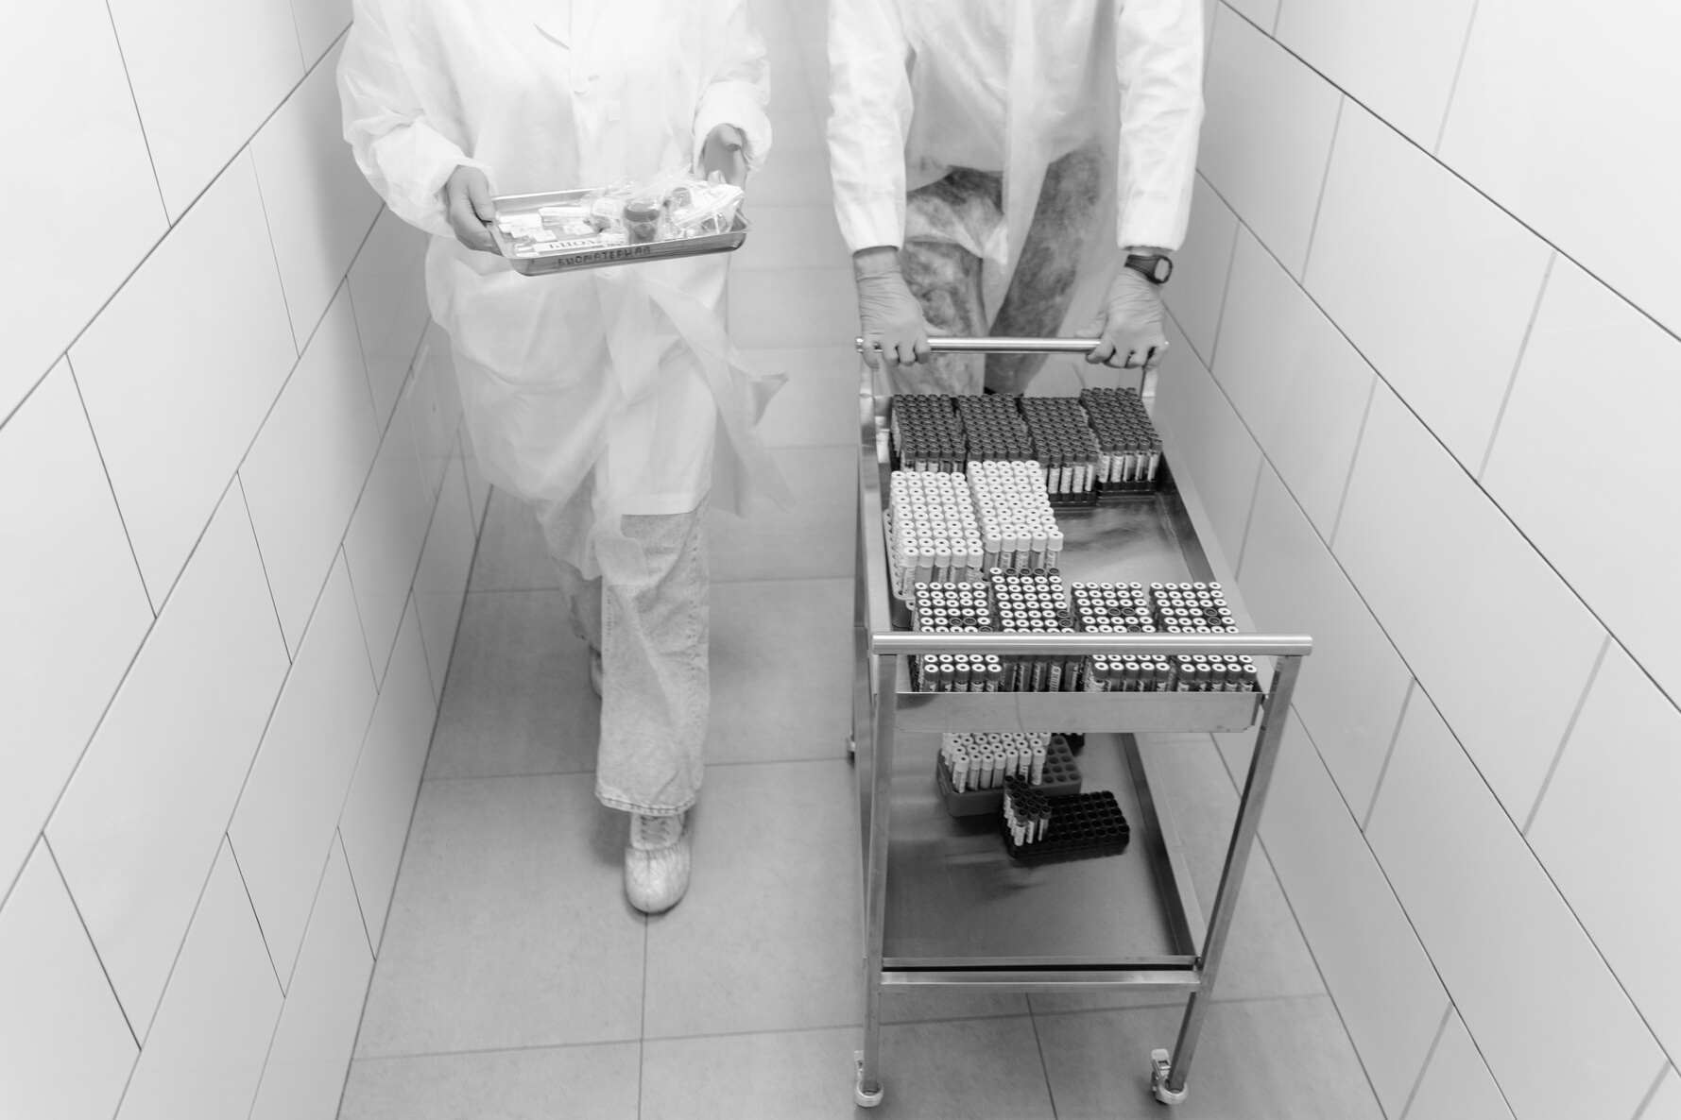
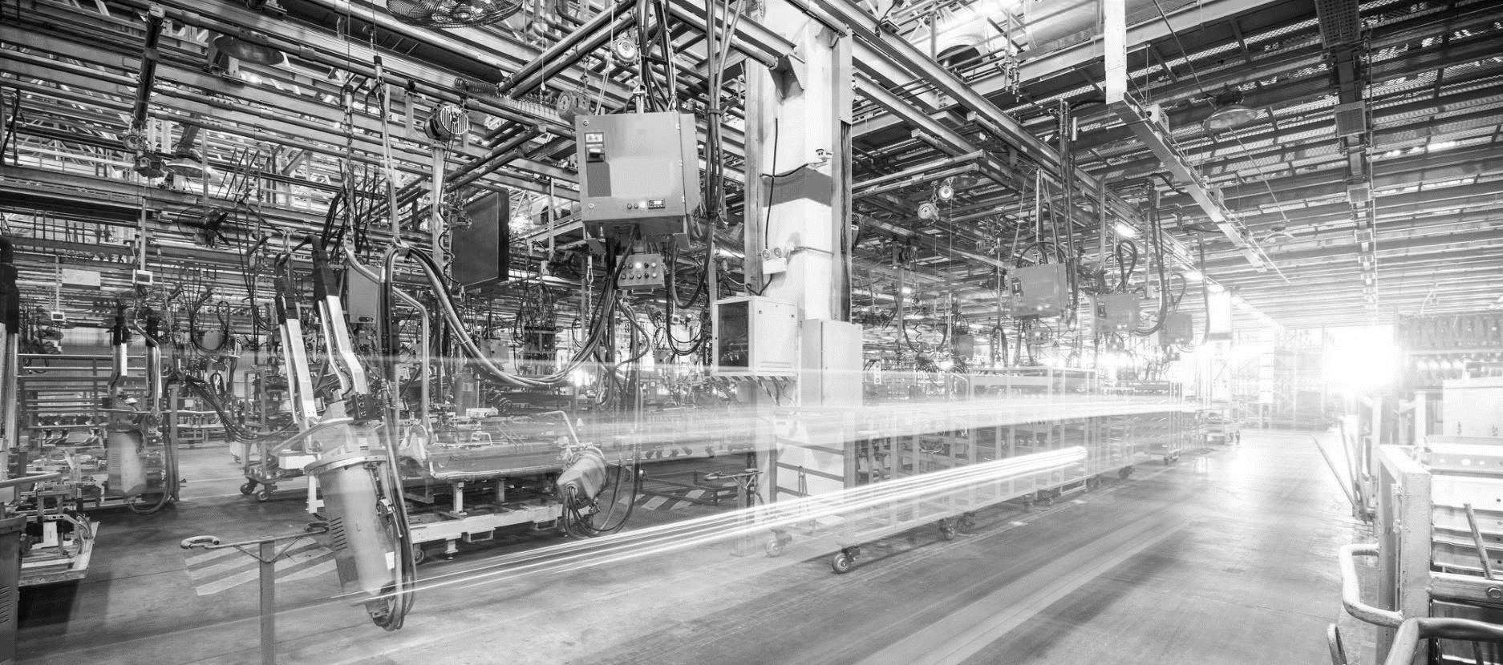
Research dataset
Size: 1M rows
Source: EU research projects 2007-2027
9 tables
Industry dataset
Size: 1M rows
Source: OCDE
1 table

Slide 5







Technology
Data source
Comsumption layer
Load
Transform
Extract

Slide 6

Technology
Speed Optimization using Parallelize + Repartion:
Test function Before = 83 sec
After = 15 sec
The whole ETL script speed improved by:
50%

Slide 7

Dashboard

